Slide 1
Decision making support for O enterprise

Slide 2
PLAN
Presentation and data pre-processing
Performance Analysis and solutions
Conclusion
Introduction
1
2
3
4

Slide 3
INTRODUCTION
Business Intelligence (BI) enables all the players in a company to have a global vision of their activities to help them in their decision-making.
Business Intelligence tools make it possible to create analyses on historical, current or even predictive data.
Given the data at O company, let's try to analyse the performances of different categories.
We will use Microsoft Excel tool to help make decisions.
1

Slide 4
Presentation and data processing
The dataset has 5101 rows and 25 attributes
Each row refers to a problem that took place in the company
The problems are identified by an Id number
The attributes are different types of characterics of
a problem.
2

Slide 5
Let’s go deeper into some attributes...

Slide 6
Number
Assignment Group
Refers to every country where O company is located including the headquarters
Refers to which team the problem is assigned. Some are EXPERT teams ex : AP and AP EXPERT )
Members of the support team. Some users might appear in this group meaning they have solved the problem by themselves
Id number of every problem. Could be our primary key.
Business Unit
Support

Slide 7
Severity
Solving code
Different levels of priority from CRITICAL, HIGH, MODERATE, LOW
The levels of harshness of a problem
STATUS=CLOSED means the problem was confirmed solved by the USER.
Helps us to know if a problem was solved permanently solved or whether it is costly to solve.
Priority
Status

Slide 8
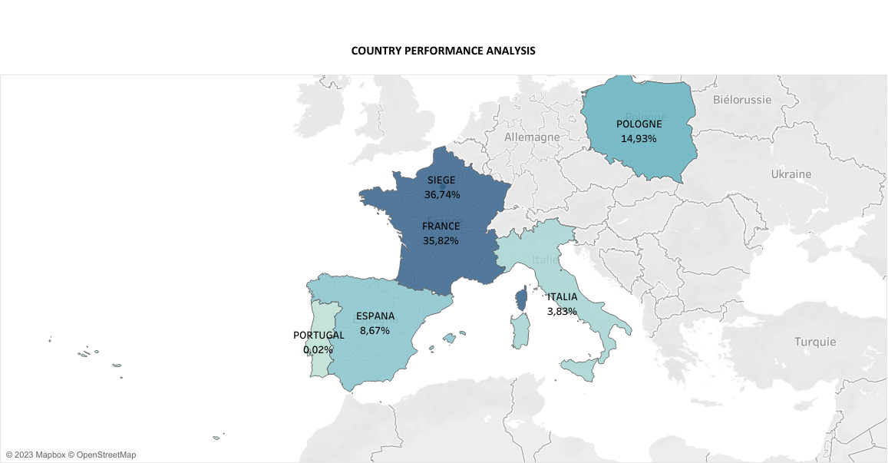
Performance Analysis and solutions
COUNTRY PERFORMANCE ANALYSIS
3

Slide 9
Performance Analysis and solutions
3

Slide 10
Performance Analysis and solutions
SOLUTIONS
3

Slide 11
Performance Analysis and solutions
3
Training sessions from France support teams to teams in Spain and Italy

Slide 12
Performance Analysis and solutions
TEAM PERFORMANCE ANALYSIS
3

Slide 13
Performance Analysis and solutions
3

Slide 14
Performance Analysis and solutions
3

Slide 15
Performance Analysis and solutions
3

Slide 16
Performance Analysis and solutions
3

Slide 17
Performance Analysis and solutions
SOLUTIONS
3

Slide 18
Performance Analysis and solutions
Distribution of knowledge to prevent our company from being too dependent on one person
Training sessions where Soukaina would help the rest of the team
3

Slide 19
Conclusion
4

Slide 20
.
.
By Support
Propositions
.
.
.
By country
By Group work
Global conclusion

Slide 21
THANK YOU

